Slide 1
Analysis of Abington Memorial Hospital
Sree Sarada Alapaty
G01440615

Slide 2
Background of the Readmissions Program:
The Hospital Readmissions Reduction Program (HRRP) is a Medicare value-based purchasing program that reduces payments to hospitals with excess readmissions. The program supports the Centers for Medicare & Medicaid Services’ (CMS’) goal of improving health care for Americans by linking payment to the quality of hospital care.
The three conditions the program was initially designed to treat—heart failure, acute myocardial infarction, and pneumonia—seemed to have lower readmission rates across the country when it was implemented.
The percentage of patients who return to the hospital after being discharged within a specific time frame is known as the readmission ratio. More readmissions than anticipated are indicated by a readmission ratio above 1, whilst fewer readmissions than anticipated are indicated by a ratio below 1.
The excess readmission ratio (ERR) is the measure we use to evaluate hospital performance. The ERR measures a hospital’s relative performance and is a ratio of the predicted-to-expected unplanned readmissions rates. For every condition in the program, we calculate an ERR: like AMI, COPD, HF, Pneumonia, CABG, Elective Primary Total Hip Arthroplasty.
The HRRP has been successful in reducing readmission rates across the United States, promoting improved overall patient care, despite some hospitals' concerns regarding equity, particularly for those serving patients affected by social issues.

Slide 3

Abington Memorial Hospital
Abington memorial hospital, was opened in May 1914 to serve for the people in and around Abington, PA. Later, in 2015 Abington Health and Jefferson Health merged resulting in Abington-Jefferson Health (now known as Jefferson Health-Abington).
The hospital has 665 beds and over 5,500 employees, including more than 1,100 physicians, and is one of the largest employers in Montgomery County, PA.
U.S. News and world Report has rated Jefferson Health-Abington hospital as top performing among Ophthalmology, ENT and in seven other specialties: Urology, Gastroenterology, Orthopedics, Pulmonology & lung surgery, Cancer and Geriatrics.

Slide 4
Analysis Goals
In the United States, several readmission ratio targets are established based on the type of hospital and condition being treated. The Centers for Medicare and Medicaid Services (CMS) have implemented readmission reduction efforts to assist hospitals in reducing their readmission rates for particular conditions.
One initiative to reduce readmission rates is the CMS Hospital Readmissions Reduction Program (HRRP), which targets patients with HF, PN, COPD, and elective HIP KNEE replacements. Under the program, hospitals that have higher than expected readmission rates are penalized.
Medicare reduced its payments to nearly 2,500 hospitals or 47% of all facilities between October 2021 and September 2022. (Kaiser Health News report)
Hospitals and healthcare systems are compelled to raise the standard of care to retain more funds internally. Making sure that patients receive appropriate care transitions, including efficient medication management, is a crucial part of any program aimed at reducing readmissions.
The main objectives of readmission ratios are to enhance patient outcomes, reduce healthcare costs, and lower readmission rates for certain conditions.

Slide 5
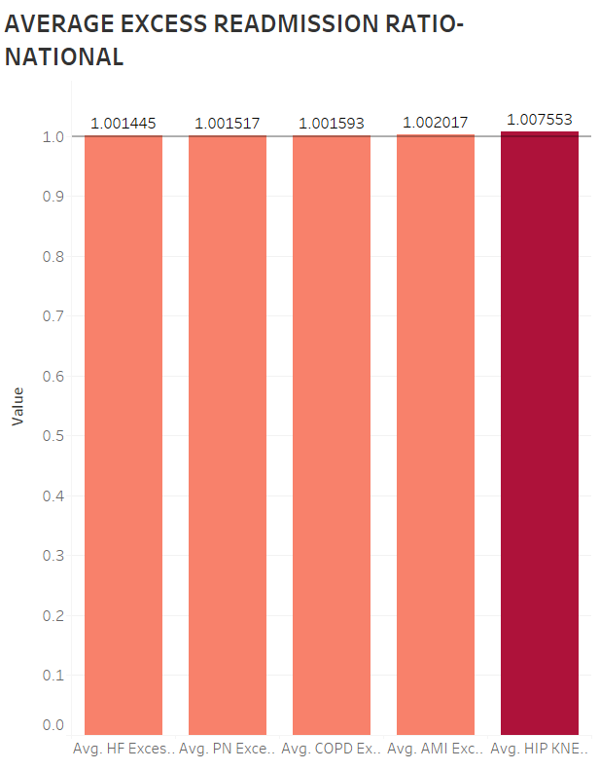
Average Excess Readmission Ratio, National Level
The average excess readmission ratio for the entire nation is displayed in this bar chart. HIP KNEE has the highest overall readmissions ratio, with AMI, COPD, and PN (pneumonia) following closely behind. Even though the results do not differ significantly, HF has a low readmission ratio when compared to other measures.

Slide 6
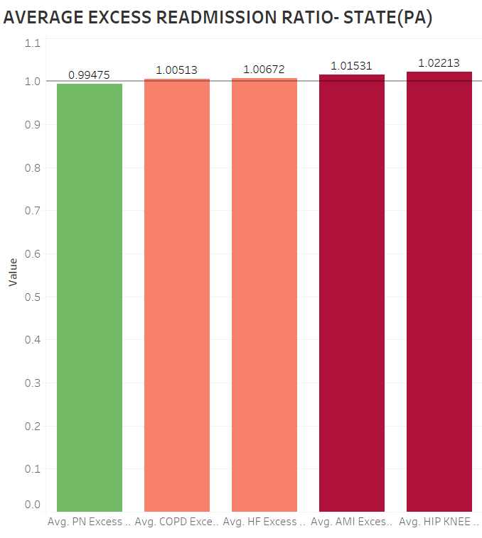
Average Excess Readmission Ratio, State Level
The state's overall average excess readmissions ratio is displayed in this bar chart. The highest readmission ratio was for HIP KNEE replacement, with AMI, HF, and COPD following. PN has a low readmission ratio in relation to other measures, even though the results do not differ significantly.

Slide 7
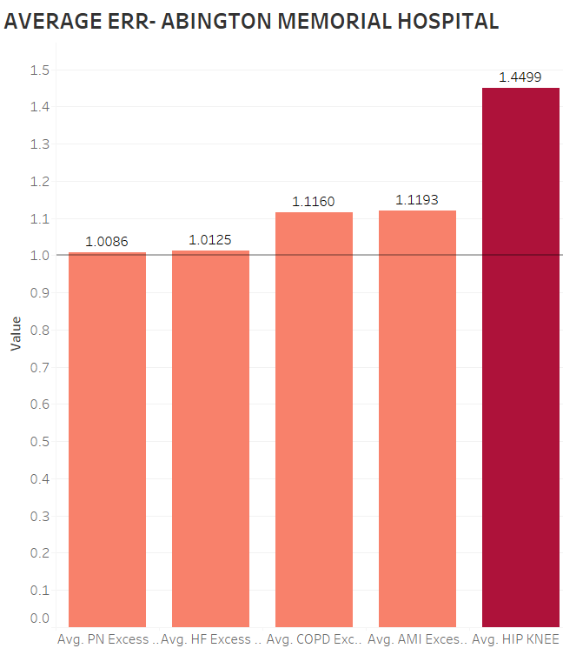
Average excess readmission ratio, Abington Memorial Hospital
This bar chart shows the Abington Memorial Hospital excess readmission ratio. The HIP KNEE replacement had the highest readmission rates, followed by AMI, COPD, and HF. Even though there is no significant difference in the results, PN has low readmission ratio when compared to other measures.

Slide 8
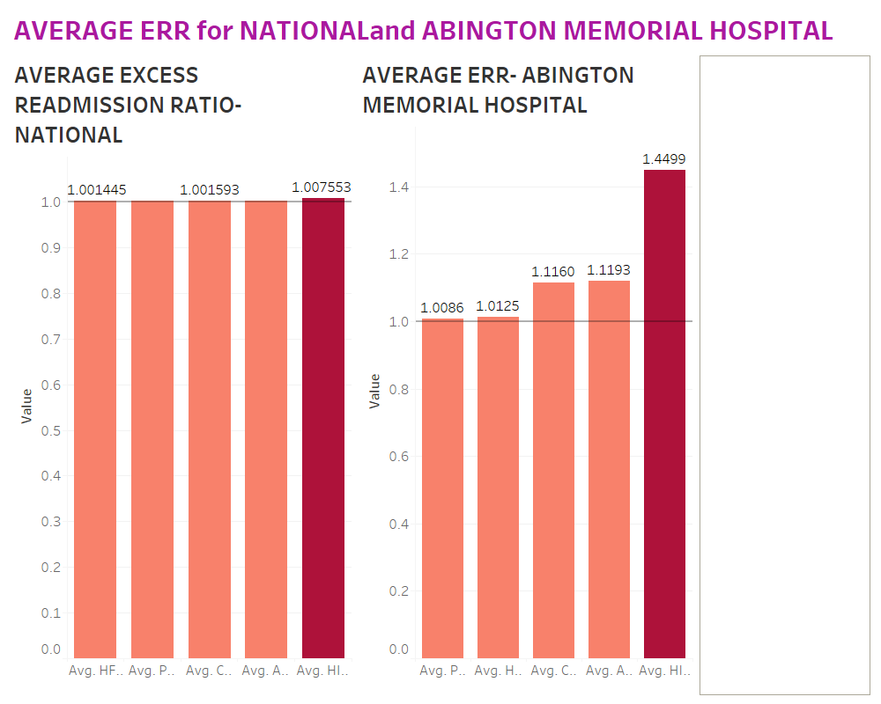
Average ERR for National and Abington Memorial Hospital
The dashboard, which is a collection of several characteristics, may be used to compare data for average ERR by National, Abington Memorial Hospital and hospitals hyperlink.
While the average ERR of HIP KNEE replacement is high for both National and Abington Memorial Hospital. And HF is low for National while PN is low for Abington Memorial Hospital with 1.0086.

Slide 9
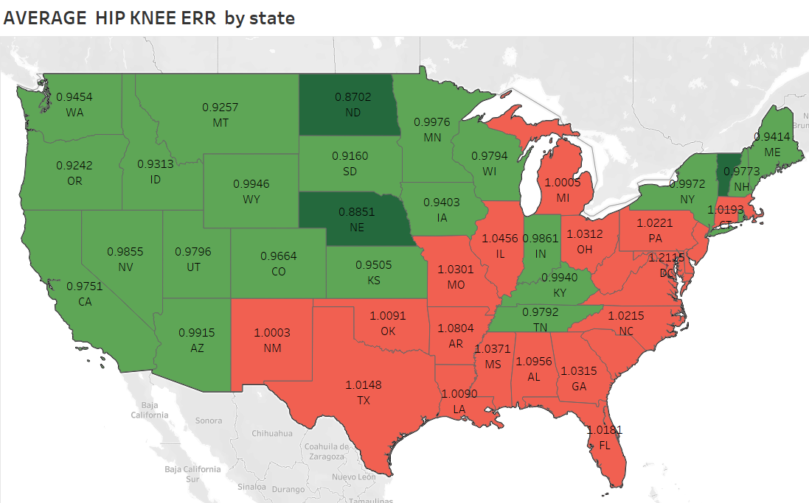
Average HIP KNEE Excess Readmission Ratio by state
The states in red color has Excess Readmission ratio more than 1, whereas states in green color has Excess Readmission ratio below 1.
The Pennsylvania (PA) had an average HIP KNEE ERR for about 1.0221. It means that people are not satisfied with the treatment they are receiving.

Slide 10
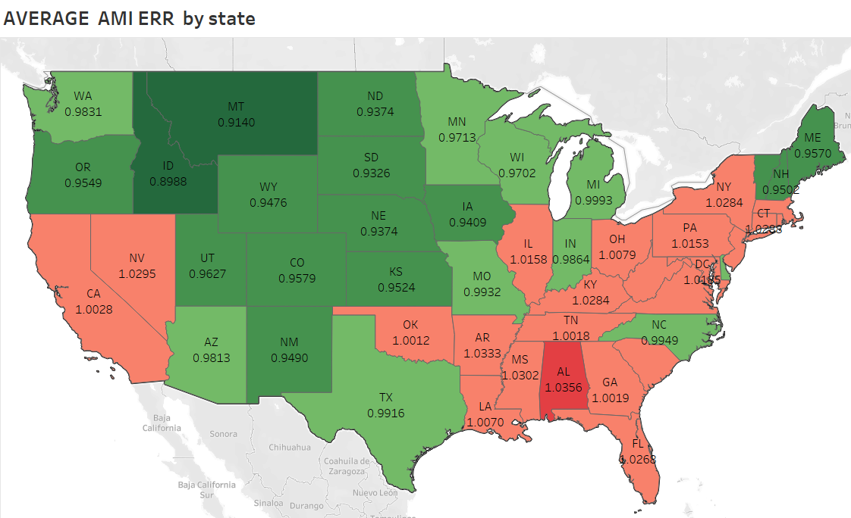
Average AMI Excess Readmission Ratio by State
The states in red color had Excess Readmission Ratio above 1, whereas the states in green color had excess readmission ratio below 1.
The Pennsylvania (PA) had an average AMI excess readmission ratio for about 1.0153. It means the people over there are not satisfied by the type of care they are receiving.

Slide 11
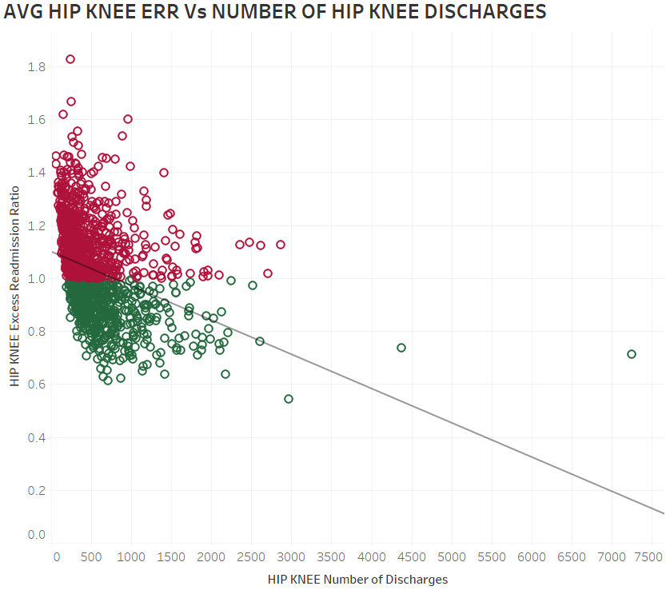
Average HIP KNEE Excess Readmission Ratio Vs HIP KNEE Number of Discharges
This scatter plot shows the relation between two variables i.e., HIP KNEE Number of Discharges on X-axis and Average HIP KNEE Excess Readmission Ratio on Y-axis.
This scatter plot explains that as the number of discharges increase there is a decrease in avg HIP KNEE excess readmission ratio.
This scatter plot shows that there is a decrease in HIP KNEE excess readmission ratio as we do more surgeries.
There are more than 2k nulls, indicating there are some hospitals where data is not recorded.
P-value is < 0.0001. So, it tells that the relationship between the variables is statistically significant.

Slide 12
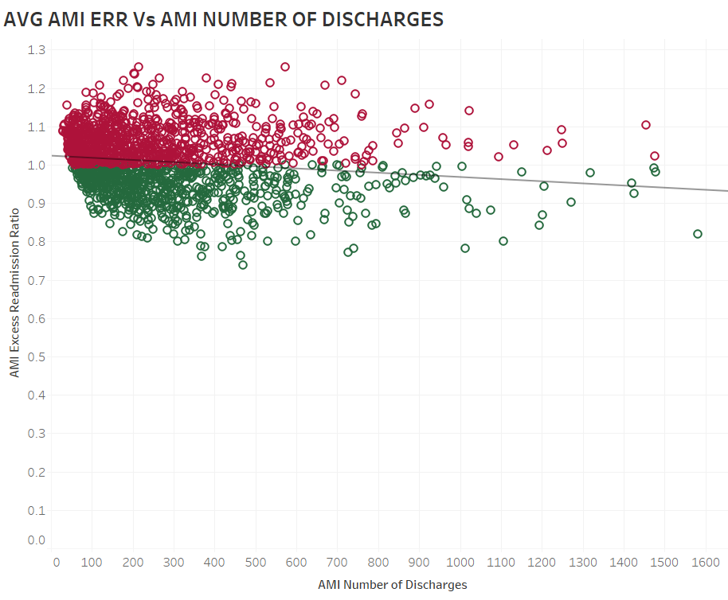
Average AMI Excess Readmission Ratio Vs AMI Number of Discharges
The scatter plot here shows a relation between two variables. Average AMI Excess Readmission Ratio on Y-axis and AMI Number of Discharges on X-axis.
This scatter plot explains that as the number of discharges increase there is a decrease in avg AMI excess readmission ratio.
The trend line here explains a linear relationship between the both.
There are more than 2k nulls, indicating there are some hospitals where data is not recorded.
P-value is < 0.0001. So, it tells that the relationship between the variables is statistically significant.

Slide 13
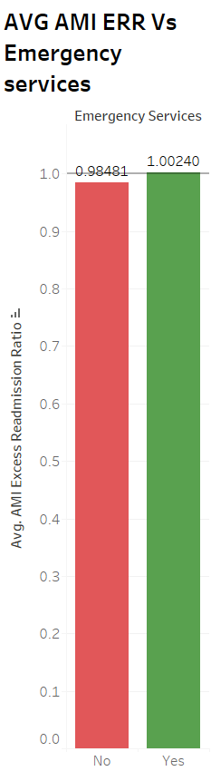
Average AMI Excess Readmission Ratio Vs Emergency Services
The bar chart depicts the relationship between the variables AMI excess Readmission ratio and other variable Emergency services.
The average excess readmission ratio for AMI is 1.00240 with emergency services as yes. The avg ERR for AMI is slightly higher here, and the emergency services were likely involved in the treatment process for these AMI cases.
Where as, the avg ERR for AMI with 0.98481 has no emergency services involved in treating them. Here the avg ERR for AMI is slightly lower.

Slide 14
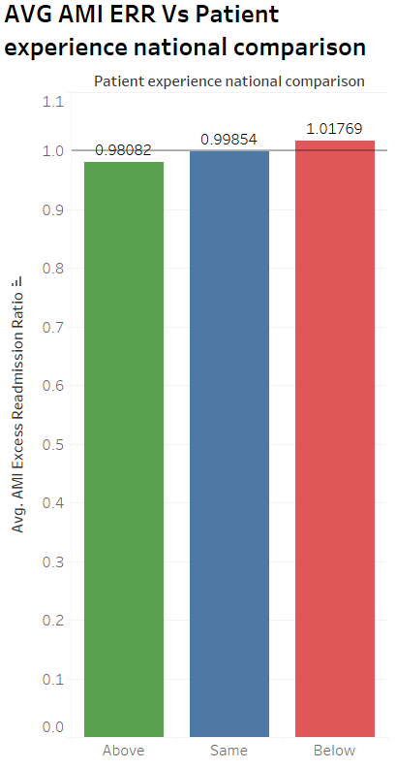
Average AMI Excess Readmission Ratio Vs Patient experience national comparison
This bar chart shows the relation between two variables Avg AMI Excess Readmission Ratio on Y-axis and Patient experience national comparison on X-axis.
This bar chart explains that the hospitals who have patient experience above the national comparison have average AMI ERR of 0.98082. So, people had a more positive experience at the hospital. The avg AMI ERR is lower now.
The hospitals who have patient experience same as national comparison have average AMI ERR of 0.99854.
And the hospitals who have patient experience below the national comparison have average AMI ERR of 1.01769.

Slide 15
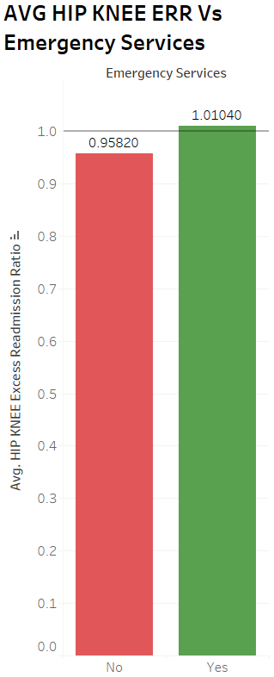
Average HIP KNEE Excess Readmission Ratio Vs Emergency Services
The bar chart depicts the relationship between the variables Average HIP KNEE excess Readmission ratio and other variable Emergency services.
The average excess readmission ratio for HIP KNEE is 1.01040 with emergency services as yes. The avg ERR for HIP KNEE is slightly higher than expected here, and the emergency services were likely involved in the treatment process for these elective HIP KNEE replacement cases.
Where as, the avg ERR for HIP KNEE with 0.95820 has no emergency services involved in treating them. Here the avg ERR for HIP KNEE is lower.

Slide 16
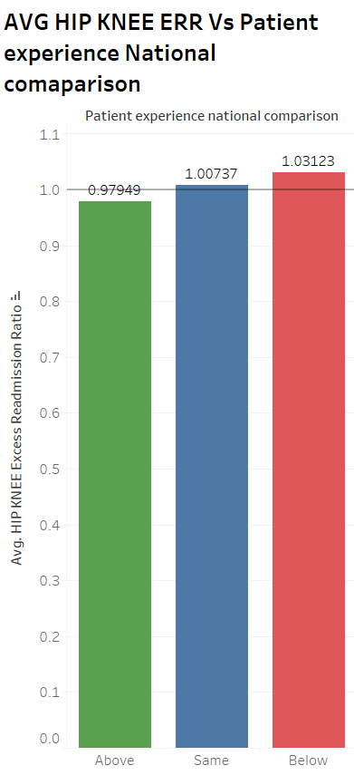
Average HIP KNEE Excess Readmission Ratio Vs Patient experience national comparison
This bar chart shows the relation between two variables Average HIP KNEE Excess Readmission Ratio on Y-axis and Patient experience national comparison on X-axis.
This bar chart explains that the hospitals who have patient experience above the national comparison have average HIP KNEE ERR of 0.97949. So, people had a more positive experience at the hospital. The avg HIP KNEE ERR is lower now.
The hospitals who have patient experience same as national comparison have average HIP KNEE ERR of 1.00737.
And the hospitals who have patient experience below the national comparison have average HIP KNEE ERR of 1.03123.

Slide 17
Findings:
According to the data, Abington Memorial hospital Excess readmission ratio for HIP KNEE is 1.4499, it means that more than expected patients were readmitted, this is not a good sign. This suggests that the hospital is not providing the care to the fullest during the initial hospital stay, and the post-discharge care was not effective in preventing readmissions.
The avg excess readmission ratio for HIP KNEE at my hospital is high when compared to state and national averages.
Abington Memorial Hospital has excess readmission ratio for PN is 1.0086, it means that more than expected patients were readmitted, which is not a good indication.
The avg excess readmission ratio for PN at Abington hospital is high when compared to state and national averages.
When it comes to HIP KNEE, data from the map reveals that much of the south – east and south- west areas have higher excess readmission ratio than other parts, whereas excess readmission ratio for AMI is higher primarily in the southeast and some parts of west region.
In the given circumstances, we observe no variation in the numbers when we examine ERR statistics at the national level. It suggests that the rate of admissions is essentially the same for all conditions.

Slide 18
Recommendations:
To reduce the readmissions at hospitals, we need to make sure to involve everyone in that process like stake holders, healthcare providers, patients and caretakers. The following are some of the suggestions that may help to reduce readmissions:
Encourage patients to schedule follow-up visits within seven days post-discharge, proven to lower 30-day readmission rates.
Recognize patient populations at an increased risk of readmission, such as Medicaid and uninsured patients.
Failure to take medications as prescribed can lead to readmissions. By giving clear instructions, streamlining drug schedules, and sending out reminders, healthcare professionals may ensure medication adherence.
Prioritize patient communication and education by employing methods like the "Teach Back" approach, resulting in a 30% reduction in 30-day and 90-day readmissions for heart failure patients.
Lowering readmission rates and improving health outcomes can be achieved through addressing socioeconomic factors affecting health, such as housing, healthcare access, and poverty.
Utilize transitional care teams or professionals to facilitate coordination and continuity of care for patients as they transition post-discharge.
Implement telemonitoring technology in the homes of chronically ill patients to monitor health status and intervene when necessary.
To reduce hospital readmissions, all parties engaged in patient care must collaborate. By implementing these ideas, healthcare professionals can enhance patient outcomes, reduce healthcare expenses, and enhance the patient experience.

Slide 19
THANK YOU

